Slide 1
Logistic Regression

Slide 2
Outline
Overview of Logistic Regression
Binary or Binomial Classification
Multi-class(Multinomial) Classification
Overview of LR
Logistic (Sigmoid) Function
Loss/Cost Function
Model Training(Learning of Parameters)
Logistic Regression Gradient Descent

Slide 3
Overview of Logistic Regression
Logistic regression is the baseline supervised machine learning algorithm for classification
It is a simple and straightforward method that can be used to predict a binary outcome.
It is also easy to interpret, as the model provides probabilities of an instance belonging to each class, which can be converted into class predictions by setting a threshold (e.g., 0.5).

Slide 4
Overview of Logistic Regression
Logistic Regression is an algorihtm to carry out classification.
Name is misleading; the word regression is due to the fact that the method attempts to fit a linear model in the feature space to fit a linear model in the feature space.
Instead of predicting class, we compute the probability of instance being that class.

Slide 5
Overview of Logistic Regression
The outcome (i.e., the probability that an instance belongs to the positive class) is modeled as a weighted sum of the input features. This means that the value of each feature is multiplied by a weight, and the resulting values are summed together to produce a prediction.

Slide 6
Overview of Logistic Regression
For example, suppose we have a logistic regression model with three input features, x1, x2, and x3, and corresponding weights w1, w2, and w3. The predicted probability of the positive class for an instance with input features x1, x2, and x3 would be calculated as:
𝑃(𝑦=1|𝑥)=𝜎(w₁x₁+w₂x₂+w₃x₃+𝑏)
where b is the bias term.

Slide 7
Classification Types
One of two classes (binary or binomial)
Sentiment: positive / negative?
Email: Spam / Not Spam?
Tumor: Malignant / Benign ?
One of many classes(Multinomial)
Sentiment: Positive / negative / neutral?
Emotion: Happy, Sad, Surprised, Angry,…?

Slide 8
Logistic Regression : Model
Logistic regression learns a vector of weights, 𝜃𝑖from a training set.
Each weight 𝜃𝑖𝜖𝑅 , is associated with one of the input features x_{i}.
The weight 𝜃𝑖 represents how important 𝐱𝐢 is to the classification decision
P(y = 1|x) is the probability that the document has positive class.
P(y = 0|x) is the probability that the document has negative class.

Slide 9

Logistic Regression : Model
ℎ𝜃(𝑥)=𝜃𝑇𝐱
Z = θ₀x₀+θ₁x₁+...+θ_{n}x_{n}
Sigmoid function
The sigmoid function (named because it looks like an s) is also called the logistic function. It maps input values to output values in the range of 0 to 1.

Slide 10
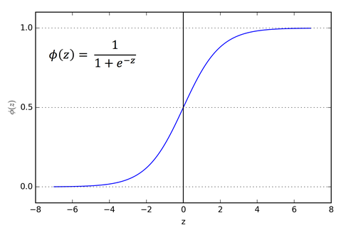
Sigmoid Function

Slide 11
Advantages of a Sigmoid
Maps real-valued numbers (R) into the range [0,1]:
The output of the model is interpretable as a probability that an input belongs to a particular class.(yes/no).
It tends to squash outlier values toward 0 or 1.
It is differentiable: The function has a relatively smooth curve, which means that the derivative of the function is relatively stable. This can make it easier for the model to learn and improve during training.

Slide 12
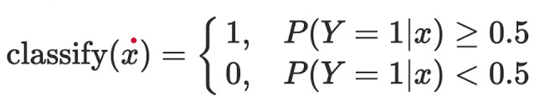
How do we decide?
For a test instance x, we say yes if the probability P(y = 1|x) is more than .5, and no otherwise.
We call .5 the decision boundary. We can also use values other than 0.5 as threshold. Assign class by applying threshold as

Slide 13
How about other thresholds?
Changing the threshold can also affect the overall performance of the model.
If the threshold is set too low, the model may classify too many inputs as belonging to the positive class. On the other hand, if the threshold is set too high, the model may classify too few inputs as belonging to the positive class.
In general, the optimal value of the threshold will depend on the specific problem we are trying to solve

Slide 14
Logistic Regression: Loss Function
Why we Sqaured function is not used?
The squared-error is not a convex function due to sigmoid operation.
Due to non-convexity, we cannot numerically solve to find the global minima.
Furthermore, the hypothesis function is estimating probability and we do not use difference operation to determine the distance between the two probability distributions.

Slide 15
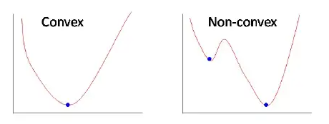
Logistic Regression: Loss Function

Slide 16
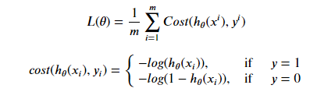

Logistic Regression: Loss Function
Cross entropy loss or Log loss function is used when classifier output is in terms of probability. Cross-entropy loss increases when the predicted probability diverges from the actual label.

Slide 17

Logistic Regression: Cost Function
Cost function is nothing but it is for whole training data, so its formula become:

Slide 18
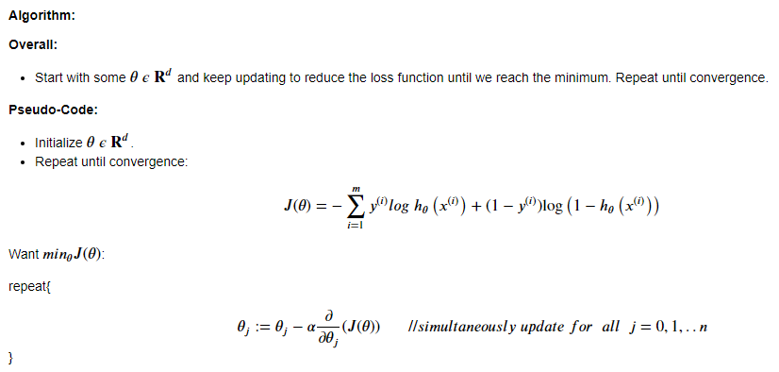
Logistic Regression: Gradient Descent
Gradient Descent is an optimization algorithm used for minimizing cost function by updating parameters of learning rate.

Slide 19

Logistic Regression: Gradient Descent
After derivation we get:

Slide 20
Performance Metrics for Classification Problems
There are various metrics which we can use to evaluate the performance of ML algorithms, classification as well as regression algorithms. We must carefully choose the metrics for evaluating ML performance because
How the performance of ML algorithms is measured and compared will be dependent entirely on the metric you choose.
How you weight the importance of various characteristics in the result will be influenced completely by the metric you choose.

Slide 21
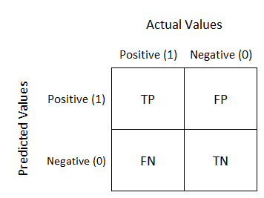
Confusion Matrix
A confusion matrix is nothing but a table with two dimensions viz. “Actual” and “Predicted” and furthermore, both the dimensions have “True Positives (TP)”, “True Negatives (TN)”, “False Positives (FP)”, “False Negatives (FN)” as shown below

Slide 22
True Positives (TP) − It is the case when both actual class & predicted class of data point is 1.
True Negatives (TN) − It is the case when both actual class & predicted class of data point is 0.
False Positives (FP) − It is the case when actual class of data point is 0 & predicted class of data point is 1.
False Negatives (FN) − It is the case when actual class of data point is 1 & predicted class of data point is 0.

Slide 23

Classification Accuracy
It may be defined as the number of correct predictions made as a ratio of all predictions made.

Slide 24

Classification Report
This report consists of the scores of Precisions, Recall, F1 and Support.
Precisions:
It is defined as the number of correct documents returned by our ML model.

Slide 25


Recall or Sensitivity
It is defined as the number of positives returned by our
ML model.
Specificity
Specificity, in contrast to recall, may be defined as the number of negatives returned by our ML model.

Slide 26
F1 Score
This score will give us the harmonic mean of precision and recall. Mathematically, F1 score is the weighted average of the precision and recall. The best value of F1 would be 1 and worst would be 0. We can calculate F1 score with the help of following formula
𝑭𝟏 = 𝟐 ∗ (𝒑𝒓𝒆𝒄𝒊𝒔𝒊𝒐𝒏 ∗ 𝒓𝒆𝒄𝒂𝒍𝒍) / (𝒑𝒓𝒆𝒄𝒊𝒔𝒊𝒐𝒏 + 𝒓𝒆𝒄𝒂𝒍𝒍)
F1 score is having equal relative contribution of precision and recall.

Slide 27
AUC (Area Under ROC curve)
AUC (Area Under Curve)-ROC (Receiver Operating Characteristic) is a performance metric, based on varying threshold values, for classification problems. As name suggests, ROC is a probability curve and AUC measure the separability. In simple words, AUC-ROC metric will tell us about the capability of model in distinguishing the classes. Higher the AUC, better the model.
Mathematically, it can be created by plotting TPR (True Positive Rate) i.e. Sensitivity or recall vs FPR (False Positive Rate) i.e. 1-Specificity, at various threshold values. Following is the graph showing ROC, AUC having TPR at y-axis and FPR at x-axis

